Slide 1
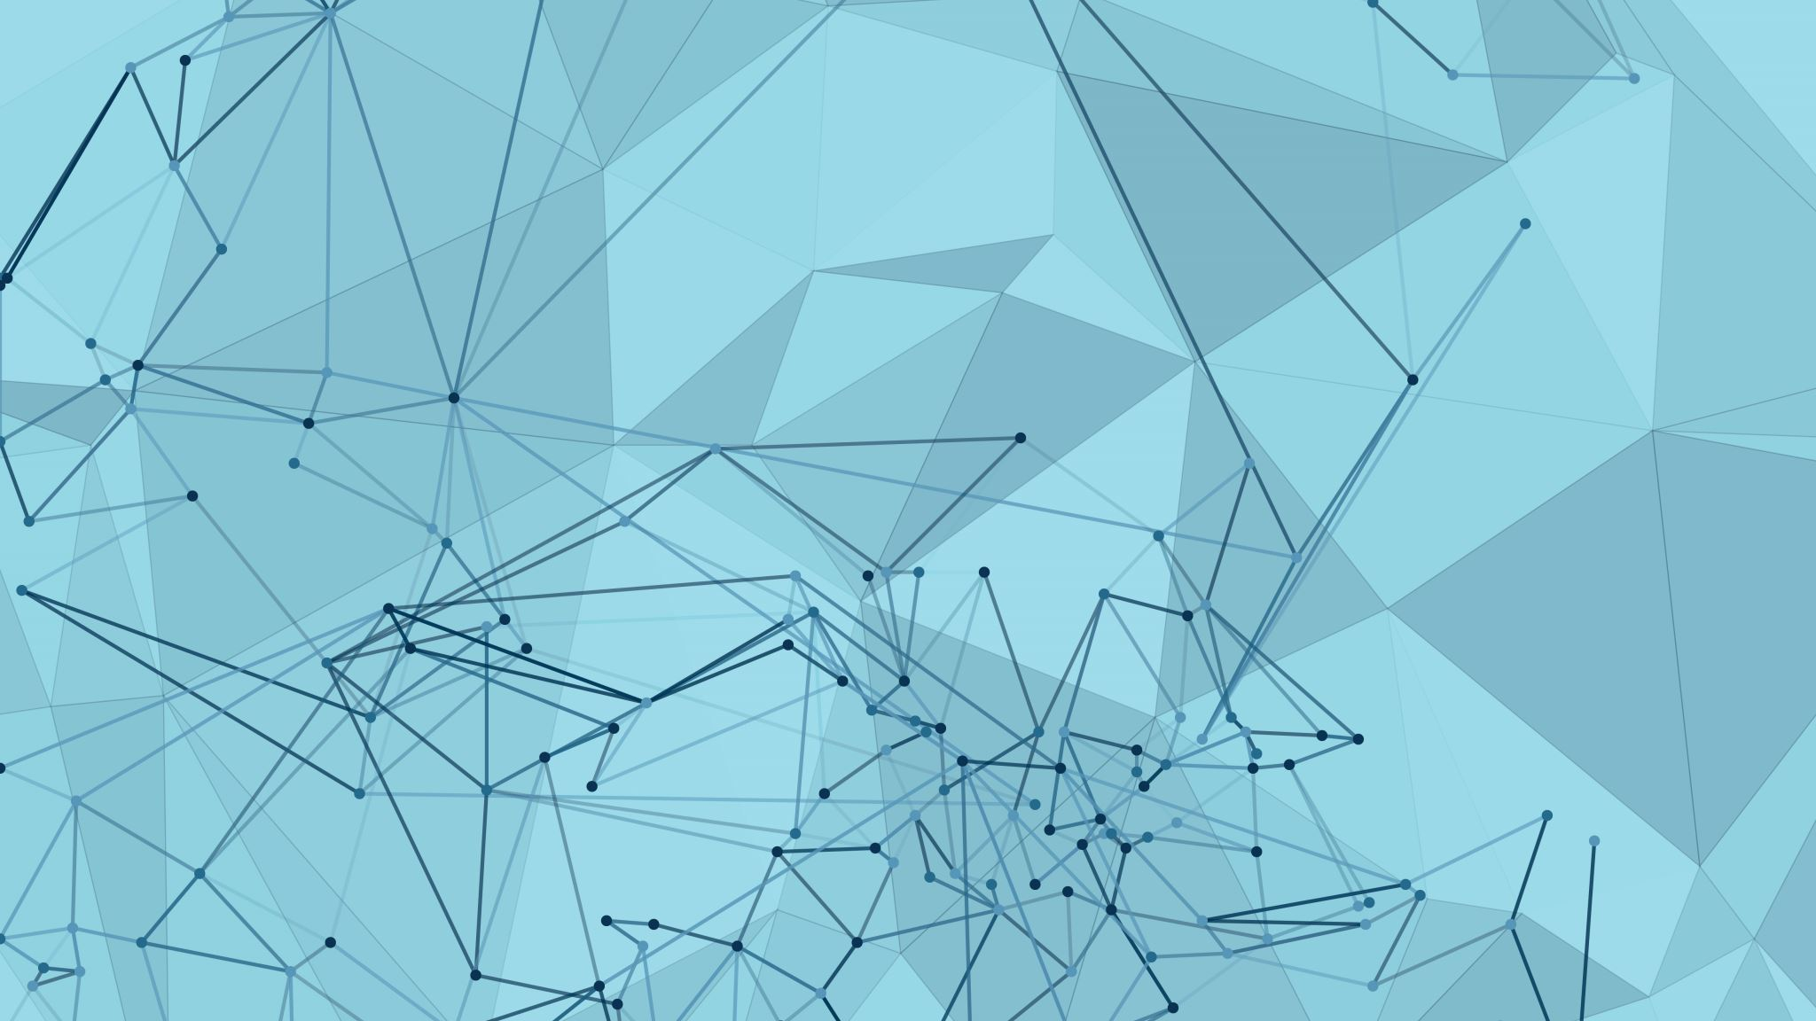
Final Project - GoodReads
Swathi T Ravichandran

Slide 2
Dataset
Goodreads is an American social cataloging website that allows individuals to search its database of books, annotations, quotes, and reviews. Users can sign up and register books to generate library catalogs and reading lists. Goodreads is owned by Amazon.
https://sites.google.com/eng.ucsd.edu/ucsdbookgraph/home - webscraped
(1) meta-data of the books, (2) user-book interactions (users' public shelves) and (3) users' detailed book reviews.
Can be merged together by matching book/user/review ids.
Complete dataset has 2,360,655 books; 876,145 users; 228,648,342 user-book interactions in users' shelves
Extracted subsets by genre – ‘Poetry’

Slide 3
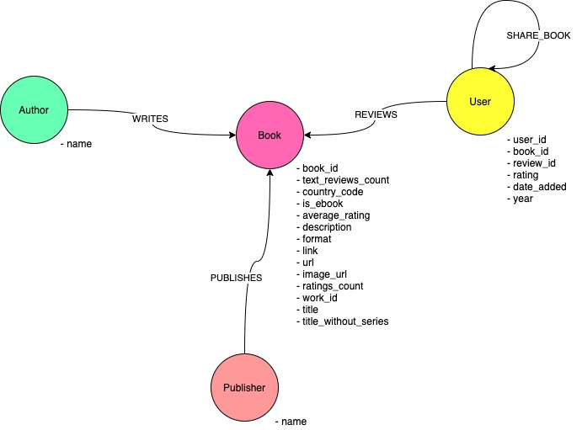
Data Model

Slide 4
Use case
Recommendation
Identify and recommend books to users by engineering network features
Influencers
Identify influential users and user groups (communities) on the Goodreads social network
Link Prediction
Predict future connections between nodes

Slide 5
What? Why? How?
What? Are there any influencers in this book based social media platform? How to suggest books to users to keep users active in the platform?
Why? Goodreads generates revenue by running ad-campaigns and book promotion campaigns. Keeping users active is big challenge.
How? recommendation system - Collaborative filtering (Jaccard similarity), finding influencers – page rank, link prediction – common neighbours, adamic adar and total neighbours
Benefits? – increase revenue from successful promotion and ad campaigns; community growth via book clubs; targeted conventions for different genres.

Slide 6

CYPHER Actions - Demo

Slide 7
CYPHER Queries
The books that have the maximum number of reviews
MATCH (b:Book) <-[:REVIEWS] - (r:User)
RETURN b.book_id, count(r.rating) AS total_ratings
ORDER BY total_ratings desc
LIMIT 10
The top 10 users who have read the most number of books of different authors.
MATCH (p1:User)-[:REVIEWS]->(b:Book)<-[:WRITES]-(a:Author)
RETURN p1.user_id AS user, count(distinct a.author) AS authors_read
ORDER BY authors_read DESC
LIMIT 10

Slide 8
CYPHER Queries
The top 10 users connected to users through books.
MATCH (p1:User)-[:REVIEWS]->(b:Book)<-[:REVIEWS]-(p2:User)
WHERE id(p1) < id(p2)
RETURN p1.user_id AS user, count(p2) AS connected_users
ORDER BY connected_users DESC
LIMIT 10

Slide 9
Recommendation Engine
Collaborative filtering instead of content filtering
Jaccard similarity algorithm
K – neighbors
N – books
Keep readers active

Slide 10
Influencers
User | Pagerank_score
2b43d97e652f1bf02658cd4bc8e5546c | 38.45124609
b206e440069b4354cb080697446c32fb | 31.8692666
8dc937307a75769f168f92f41ac926f8 | 20.97826137
b8cdfdc6e1bec90b41d76554d054f198 | 20.7844579
16c290c60df31f55c2d97c5e6eb967c0 | 17.22663135
08f7405afbb6de41afe578d662aeb4b7 | 14.58558459
2bb0e4aaf5818bbd2b32de0c393c9797 | 12.49218113
9512d6fc6afb38bd4abe72d1e34feb00 | 12.46605365
b0378a973f9554c2edf14eeb725aad82 | 12.08886424
85fbbc5bc645aa687faa812aad8a1005 | 11.4045796
806f099caa90924267fca26c54d9f403 | 11.36539061
0407dfb588958f8bb20081f9ecc4e8a4 | 9.373518034
1f07d207af61f09c6e854845eecb9ddd | 8.881217806
2a6413ef928c0044068055dcb8d0e90b | 8.602647848
e43f2d7e90dcb48918840ac01a89d74b | 8.58385608
6b73d1026d4b4c72e0c93a8fa2e3bec4 | 8.218716295
a6236695e43a28c2508df93a27a03848 | 8.011553875
05df59533c272cc54dab9b9fac53fef4 | 7.918855304
666f47b2c54f8901b1bf9a3d8c33bb6a | 7.024543846
2f0fce80342f3af9111c30db0c7c5728 | 7.017419462
“A Social Media Influencer is a user on social media who has established credibility in a specific industry. A social media influencer has access to a large audience and can persuade others by virtue of their authenticity and reach.”
User – book – user CYPHER projection folded on book edge
Pagerank algorithm
Ready and easy targets for book campaigns and book promotions

Slide 11
Community Detection
User – book – user CYPHER projection folded on book edge
Lovain community detection algorithm
Community detection can be used to detect groups to gauge interest and test a book before full release – AB testing (kinda!)

Slide 12
Link Prediction
See any expansion in the network in the future
Common neighbors, adamic adar, total neighbours algorithms to compute the closeness between nodes
Machine learning – random forest algorithm – to predict future links between nodes
Book club suggestions/facilitate book based conventions
Predict community expansions and leverage it for other profitable activities – book bundle sales

Slide 13

Questions?

